Slide 1
Exploiting Information Extraction and the Semantic Web at Yahoo
PETER MIKA⎪ October 21, 2013

Slide 2
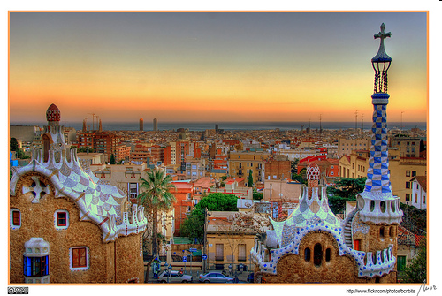
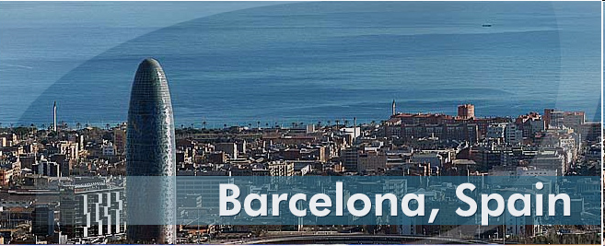
Yahoo! Labs Barcelona
Established January, 2006
Led by Ricardo Baeza-Yates
Research areas
Web Mining
content, structure, usage
Social Media
Distributed Systems
Semantic Search

Slide 3
Agenda
(Web) Search today
Semantic Search
Information Extraction
Content
User intents
Interaction

Slide 4
Web Search today

Slide 5
The web search perspective
Web search today is really fast, without necessarily being intelligent
A search engine without any understanding
Trends
Convergence of search and online media
End of the 10 blue links
Personal, social search
Search over my world
Search using my profile
New interfaces
Contextual, interactive
Search that anticipates

Slide 6
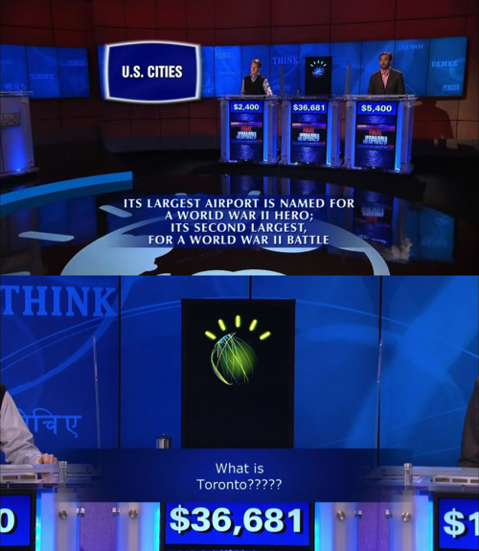
Search is really fast, without necessarily being intelligent
Could Watson explain why the answer is Toronto?

Slide 7
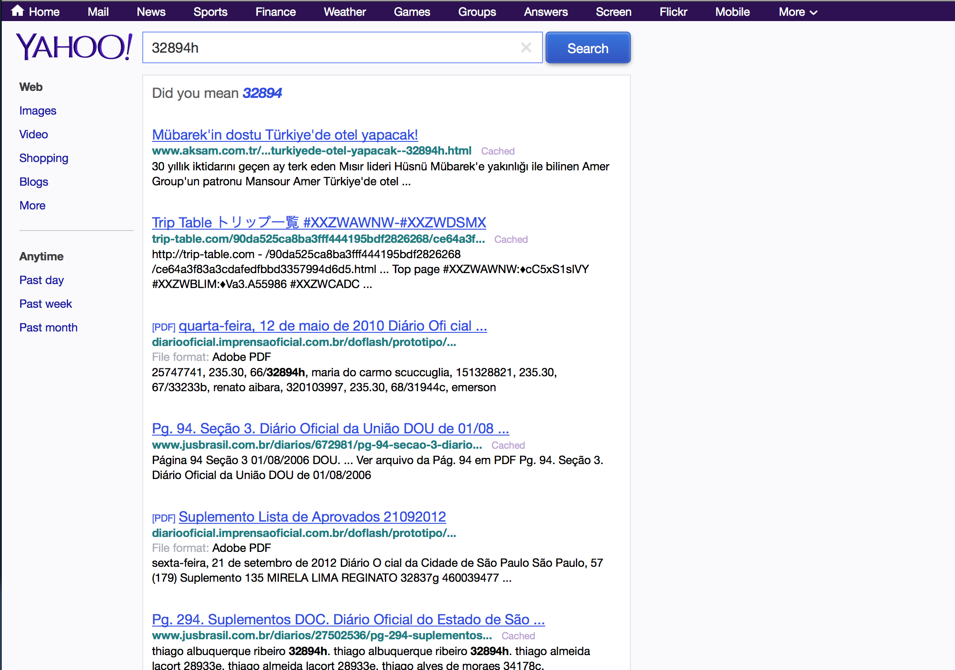
We came to bury the 10 blue links
Meaningless query

Slide 8
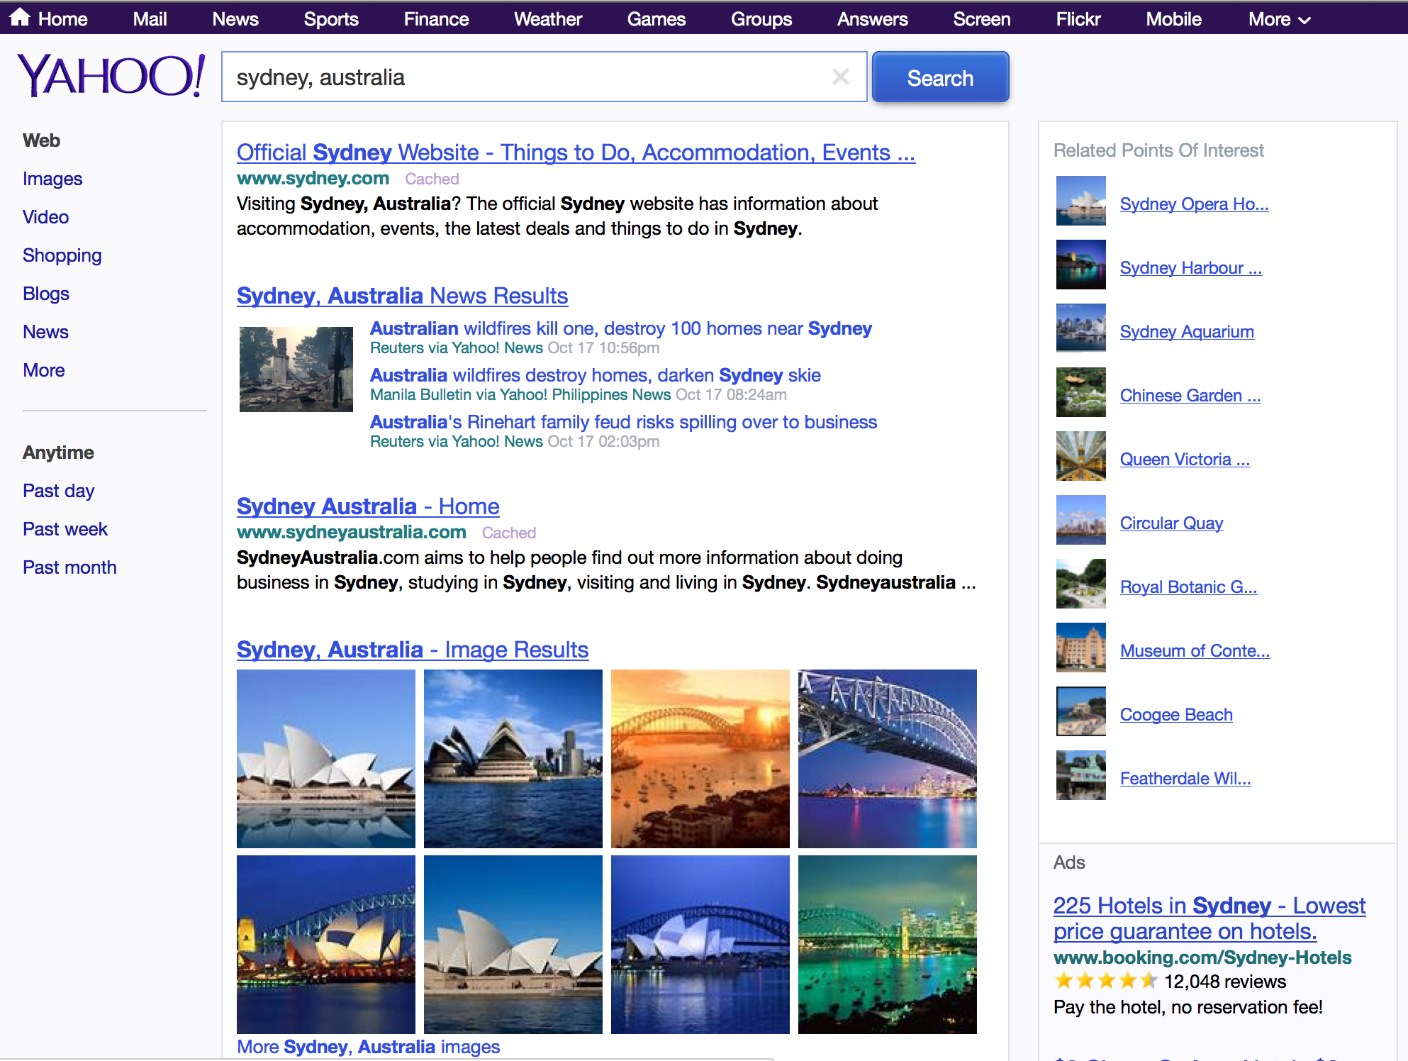
We came to bury the 10 blue links
Meaningful
query

Slide 9
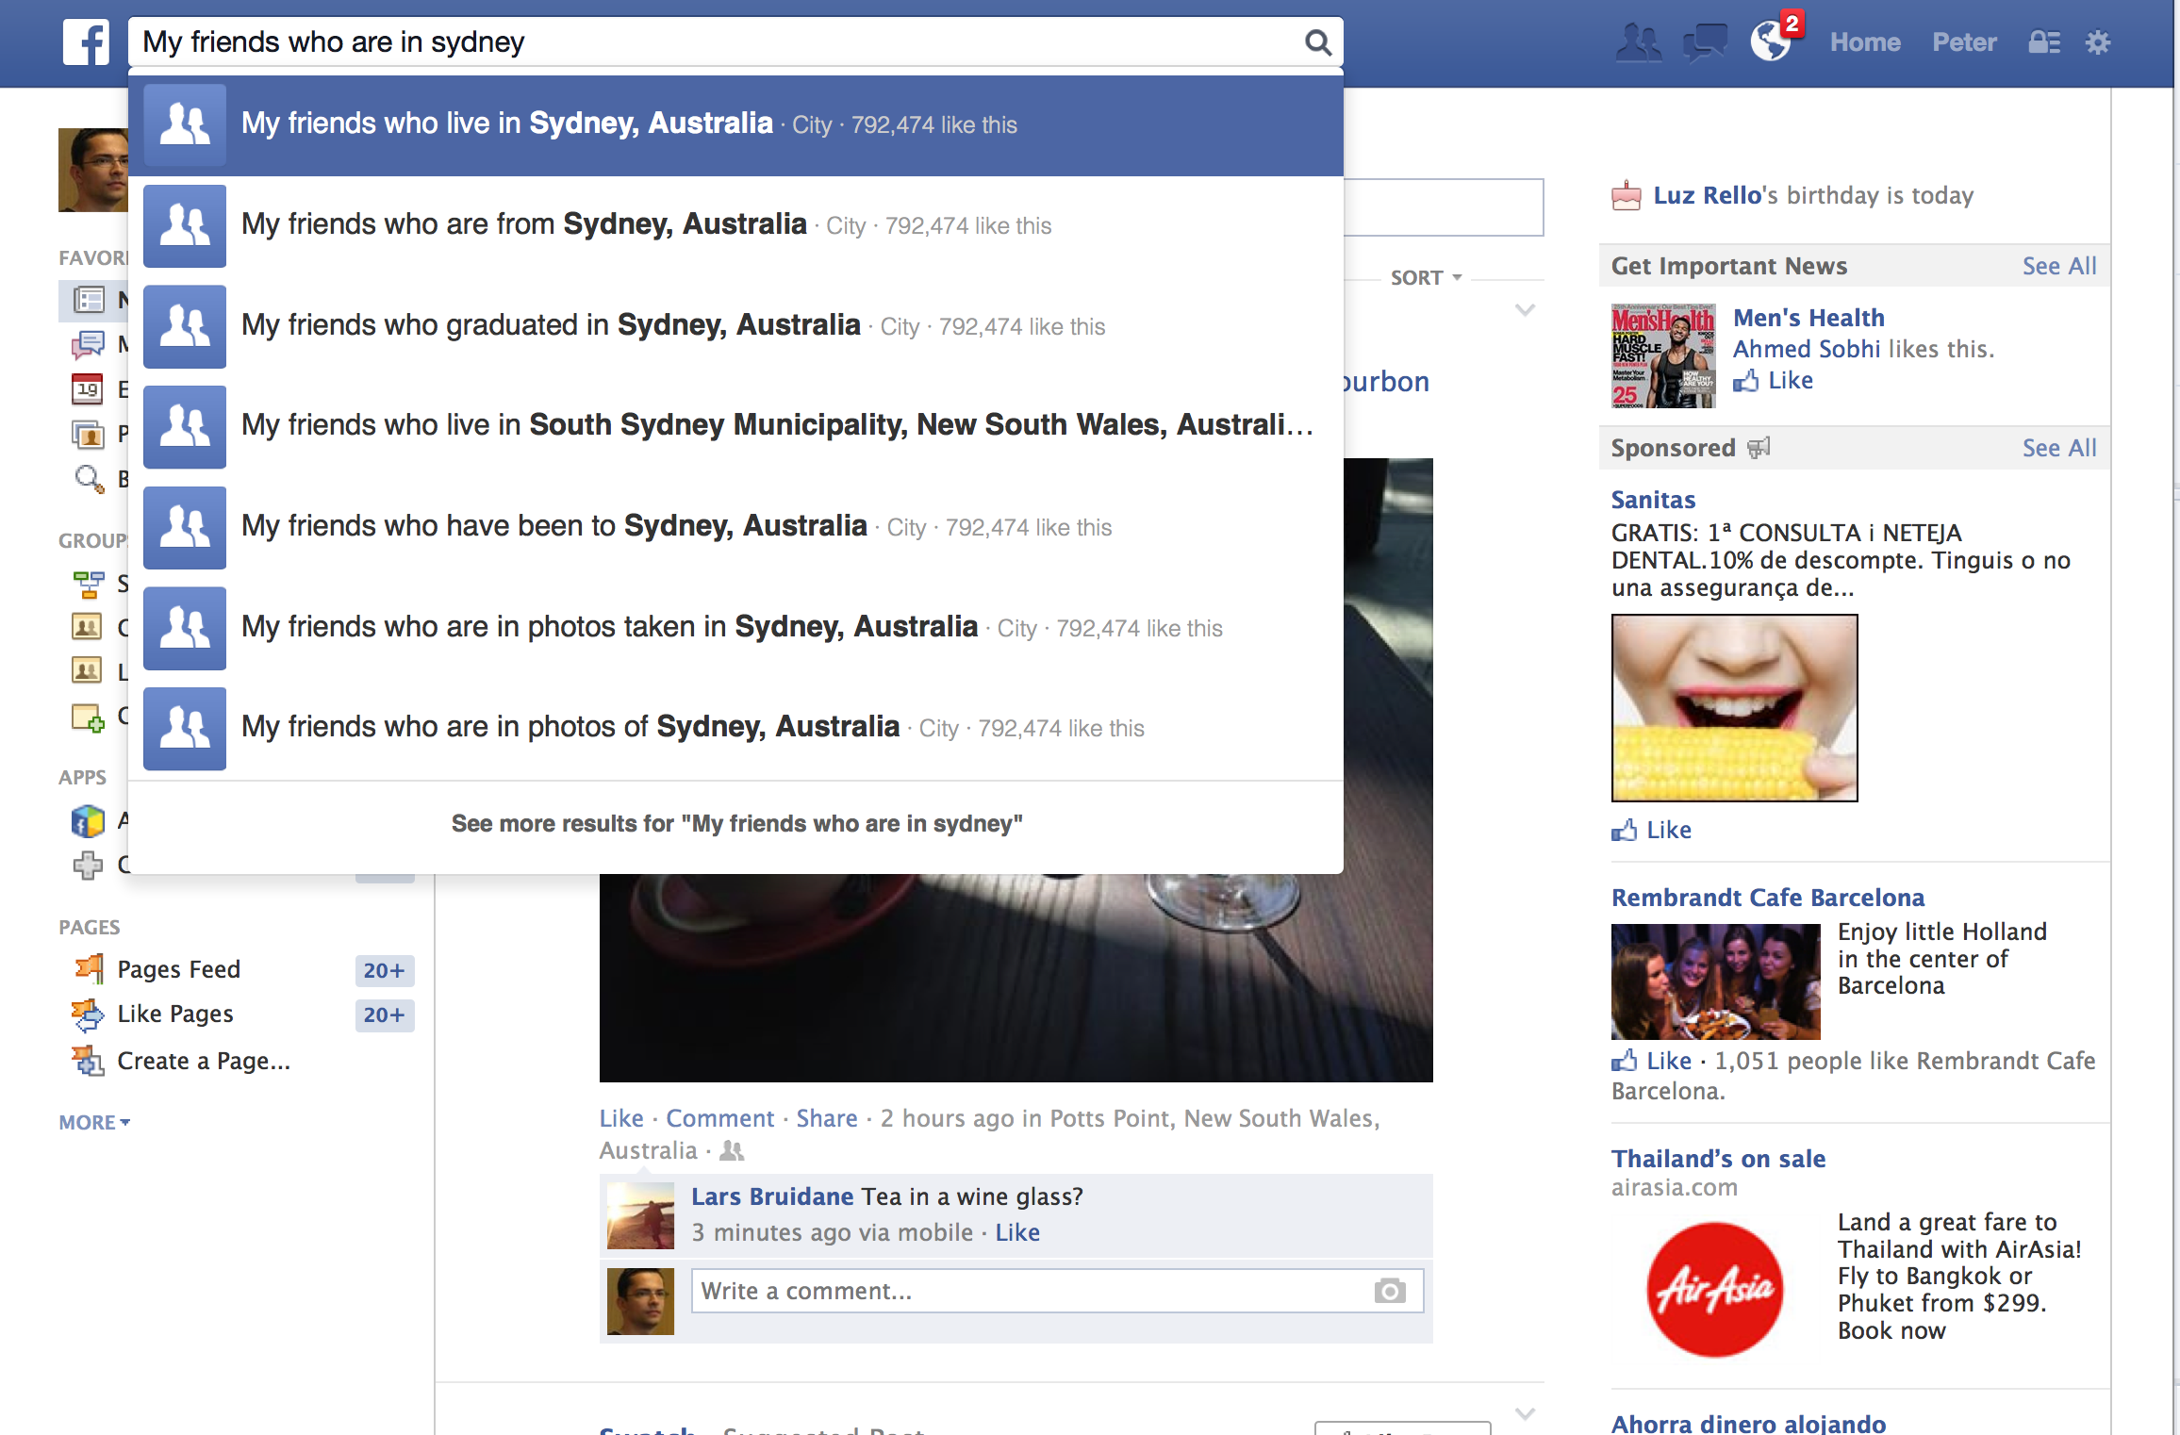
Social search
Facebook is a search engine

Slide 10
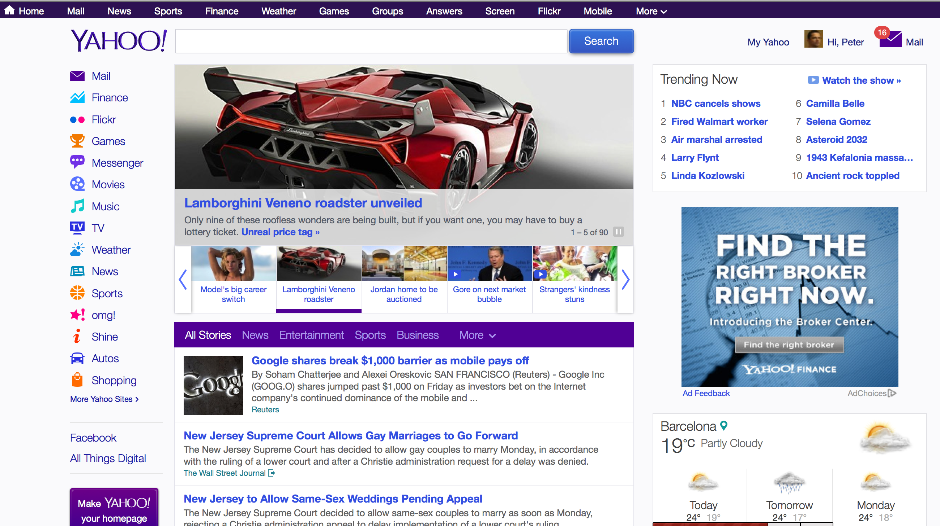
Personalized search
Yahoo news feed is a personalized
search engine

Slide 11

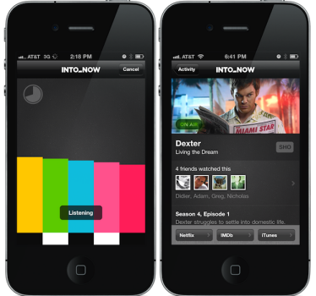
Contextual search
Yahoo’s Intonow and Connected TV:
Recommendations based on what you are watching

Slide 12
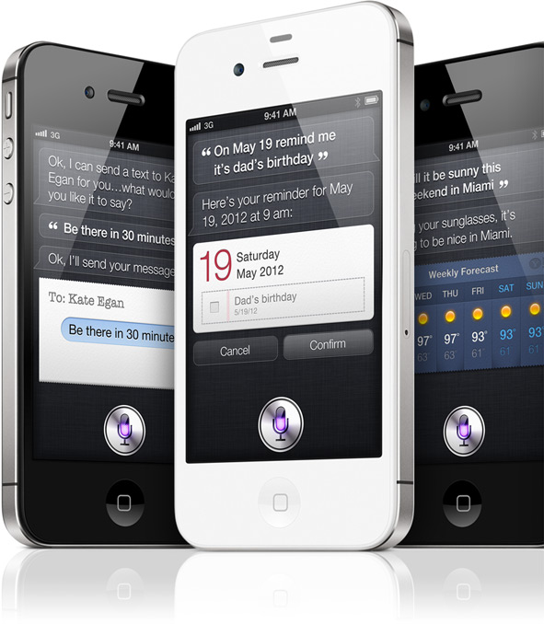
Interactive Voice Search
Apple’s Siri
Question-Answering
Variety of backend sources including Wolfram Alpha and various Yahoo! services
Task completion
E.g. schedule an event
Google Now

Slide 13


Conversational search
Interactive dialog systems
Complex dialogs around a set of objects
Restaurant
Area
Price range
Type of cuisine
Complete system (mixed licence)
Automated Speech Recognition (ASR)
Spoken Language Understanding (SLU)
Interaction Management
Knowledge Base
Natural Language Generation (NLG)
Text-to-Speech (TTS)
Video

Slide 14
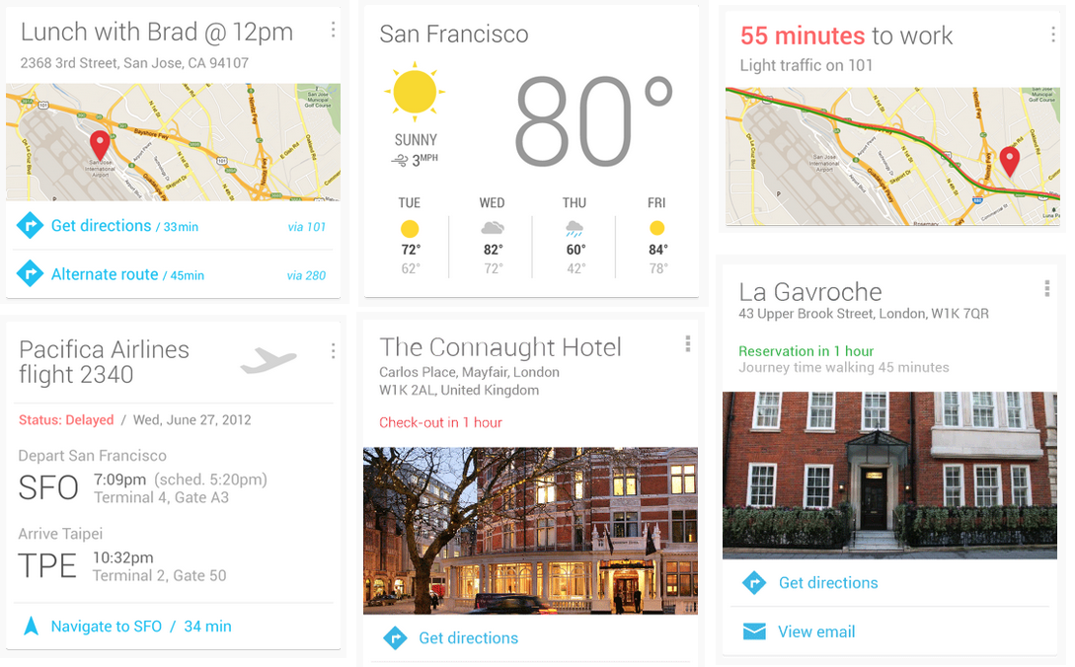
Search that anticipates
Google Now
Star Trek computer
Jason Douglas: Structured Data at Google, SemTechBiz SF 2013

Slide 15
Summary
If we want to…
Answer queries, not just show links
Personalize search
Take context into account
Anticipate user needs
… we need to understand users, content and the world at large!

Slide 16
Semantic Search

Slide 17
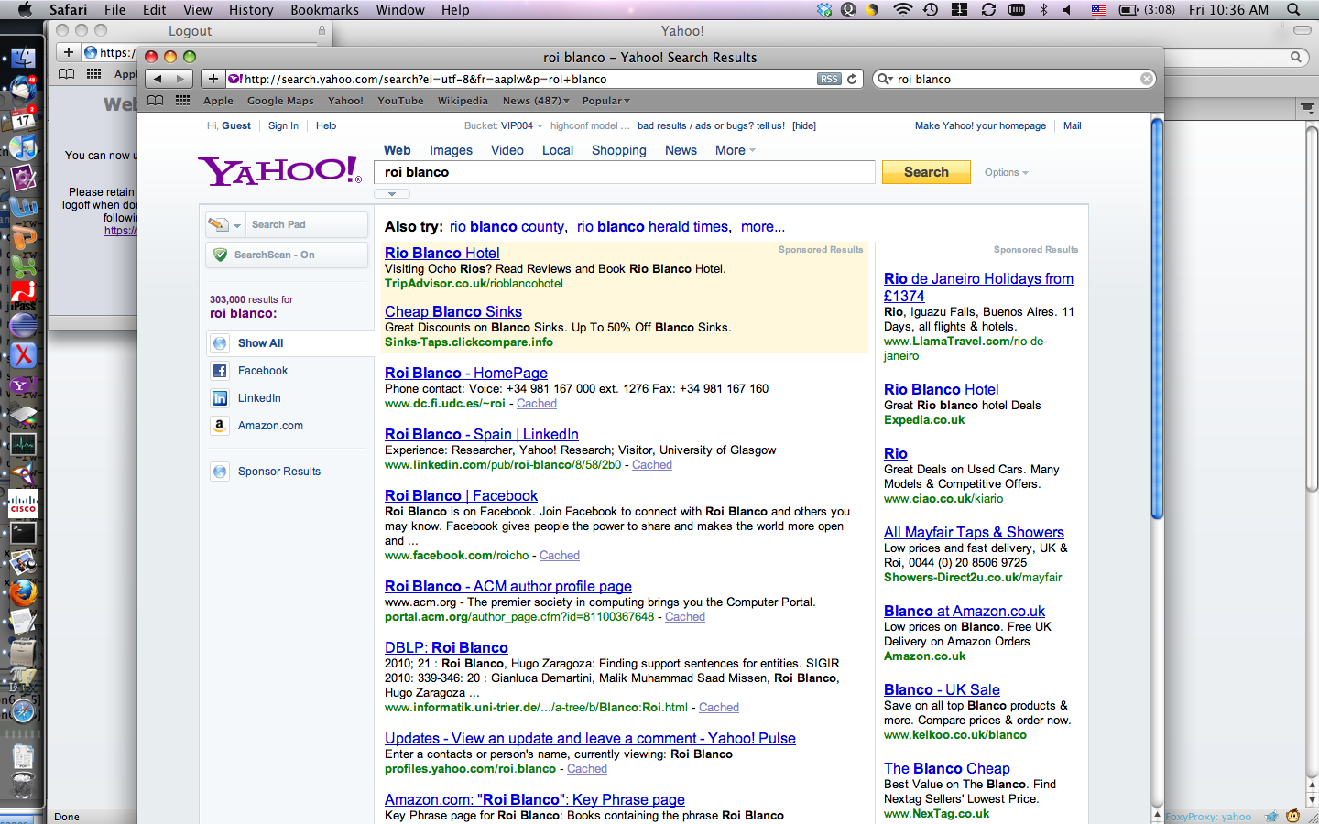



What it’s like to be a machine?
Roi Blanco
Notes:
This is how a human sees the world.

Slide 18
What it’s like to be a machine?
✜Θ♬♬ţğ√∞§®ÇĤĪ✜★♬☐✓✓
ţğ★✜➔⬆⬆⬆⬆
✪✚✜ΔΤΟŨŸÏĞÊϖυτρ℠≠⅛⌫Γ
≠=⅚©§★✓♪ΒΓΕ℠
✖Γ♫⅜±⏎↵⏏☐ģğğğμλκσςτ
⏎⌥°¶§ΥΦΦΦ✗✕☐
✜Θ♬♬ţğ
Notes:
This is how a machine sees the world… Machines are not ‘intelligent’ and can not ‘read’… they just see a string of symbols and try to match the users input to that stream.

Slide 19
Semantic Search: a definition
Semantic search is a retrieval paradigm where
User intent and resources are represented using semantic models
Not just symbolic representations
Semantic models are exploited in the matching and ranking of resources
Often a hybrid of document and data retrieval
Documents with metadata
Metadata may be embedded inside the document
I’m looking for documents that mention countries in Africa.
Data retrieval
Structured data, but searchable text fields
I’m looking for directors, who have directed movies where the synopsis mentions dinosaurs.
Wide range of semantic search systems
Employ different semantic models, possibly at different steps of the search process and in order to support different tasks
Notes:
Semantic search can be seen as a retrieval paradigm
Centered on the use of semantics
Incorporates the semantics entailed by the query and (or) the resources into the matching process, it essentially performs semantic search.

Slide 20
Semantic Search – a process view
Knowledge Representation
Query Construction
Query Processing
Result Presentation
Query Refinement
Keywords
Forms
NL
Formal language
IR-style matching & ranking
DB-style precise matching
KB-style matching & inferences
Summarization
Query visualization
Document and data presentation
Implicit feedback
Explicit feedback
Incentives
Semantic Models
Resources
Documents
Document Representation

Slide 21
The role of Information Extraction in Semantic Search
Making sense of
Content
Web, News, Twitter, email, etc.
User behavior
Not just queries, also interaction
Mapping to an abstract representation
Linguistic models
Taxonomies, thesauri, dictionaries of entity names
Natural language structures extracted from text, e.g. using dependency parsing
Inference along linguistic relations, e.g. broader/narrower terms, textual entailment
Conceptual models
Ontologies capture entities in the world and their relationships
Words and phrases in text or records in a database are identified as representations of ontological elements
Inference along ontological relations, e.g. logical entailment

Slide 22
Understanding content

Slide 23
Linguistic Representations of Text
Word-sense
disambiguation
born S#2: (v) give birth, deliver, bear, birth, have (cause to be born) "My wife had twins yesterday!"
Root
Dependency
parsing
Part-of-Speech
tagging
÷£¿≠¥ ÷ŝc£ËËð №£Ë ¿¥r© ŝ© X£≠£g£, Ë÷£ŝ©.
NNP
VBD
VBN
IN
NNP
NNP
was
№£Ë
Picasso
IR
born
÷ŝc£ËËð
¿¥r©
Pablo
X£≠£g£
÷£¿≠¥
Málaga
Spain
Ë÷£ŝ©
÷£¿≠¥ ÷ŝc£ËËð №£Ë ¿¥r© ŝ© X£≠£g£, Ë÷£ŝ©.
Text
Pablo Picasso was born in Málaga, Spain.

Slide 24
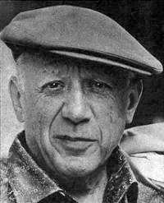


Conceptual Representations of Text
city-in
Mapping to
ontology
(NED)
born-in
÷£¿≠¥ ÷ŝc£ËËð №£Ë ¿¥r© ŝ© X£≠£g£, Ë÷£ŝ©.
NER
÷£¿≠¥ ÷ŝc£ËËð №£Ë ¿¥r© ŝ© X£≠£g£, Ë÷£ŝ©.
PER
LOC
LOC
was
№£Ë
Picasso
IR
born
÷ŝc£ËËð
¿¥r©
Pablo
X£≠£g£
÷£¿≠¥
Málaga
Spain
Ë÷£ŝ©
÷£¿≠¥ ÷ŝc£ËËð №£Ë ¿¥r© ŝ© X£≠£g£, Ë÷£ŝ©.
Text
Pablo Picasso was born in Málaga, Spain.

Slide 25
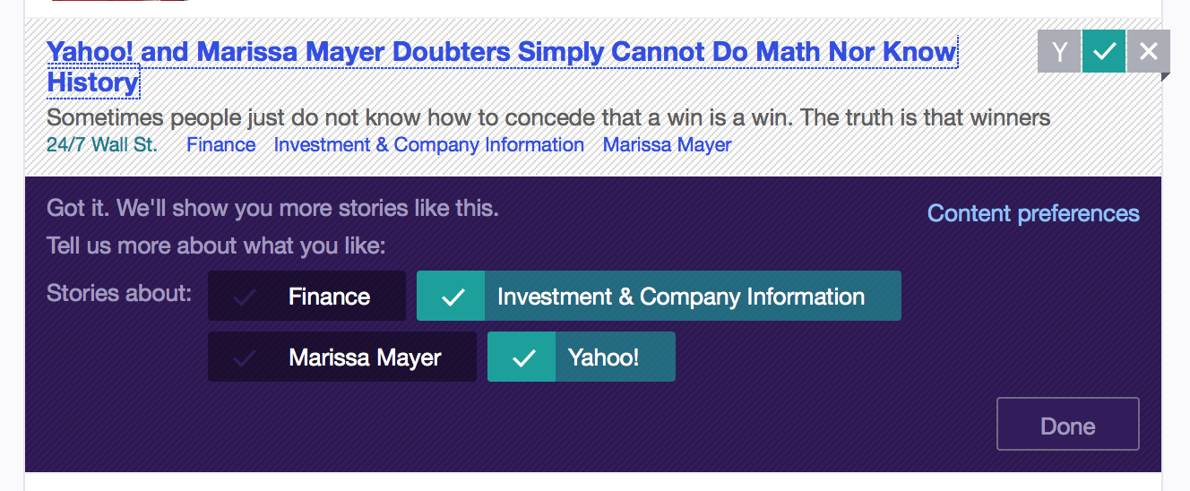
Information Extraction from text
Personalization on yahoo.com
NLP pipeline for NER, NED and aboutness ranking
Entity-graph based on Linked Data sources (Wikipedia, Freebase, Y! data)
Profile based on past reading behavior, Facebook profile, implicit feedback
Concepts from a news taxonomy and entity-graph

Slide 26
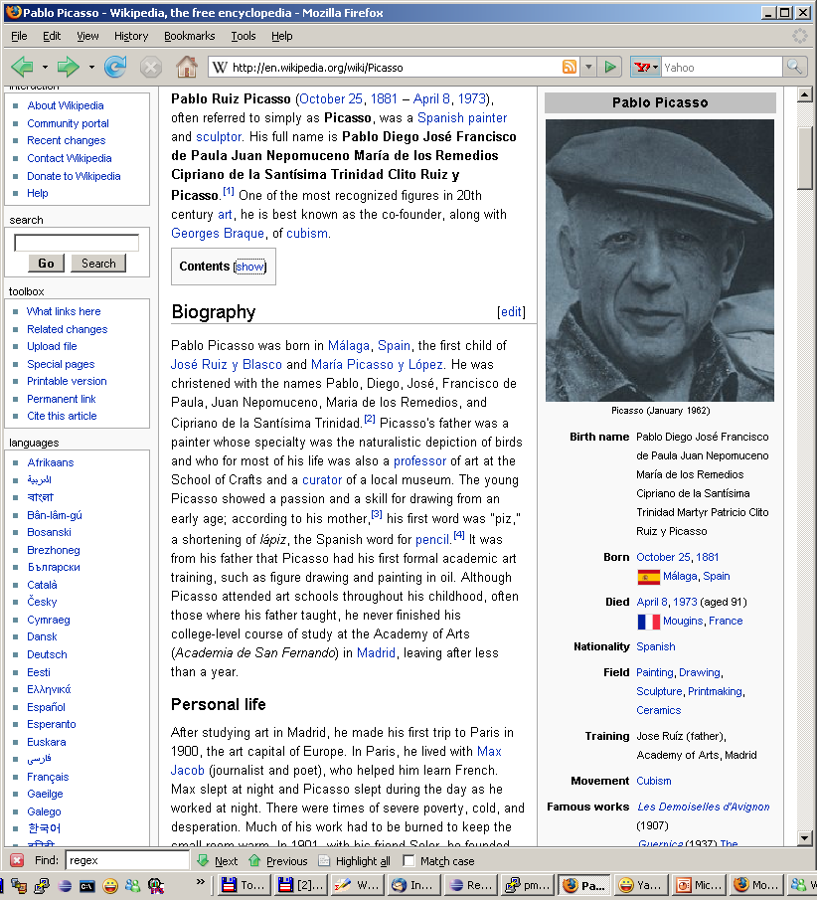
Exploiting Linked Data

Slide 27
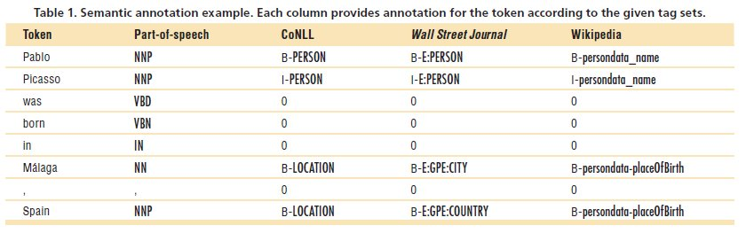
Mapping structured and unstructured data
Parallel annotations of English Wikipedia
Tagged using the SuperSense Tagger trained on CoNLL and WSJ data
Tagged by the property that provides the value found in text
P. Mika et al.: Learning to Tag and Tagging to Learn: A Case Study on Wikipedia. IEEE Intelligent Systems 23(5): 26-33 (2008)
If most places of birth are locations, then let’s assume all are.

Slide 28
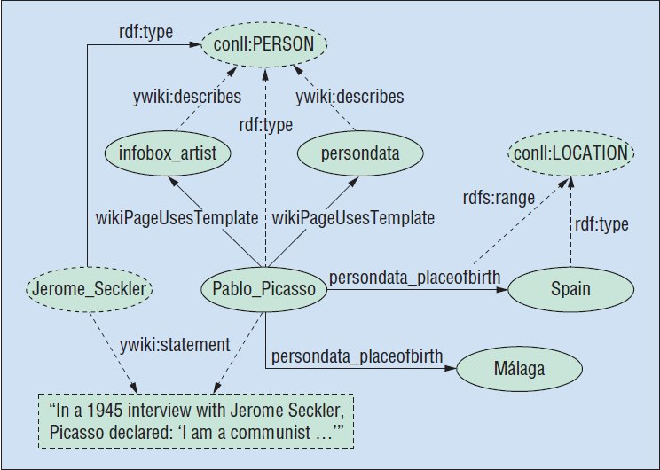
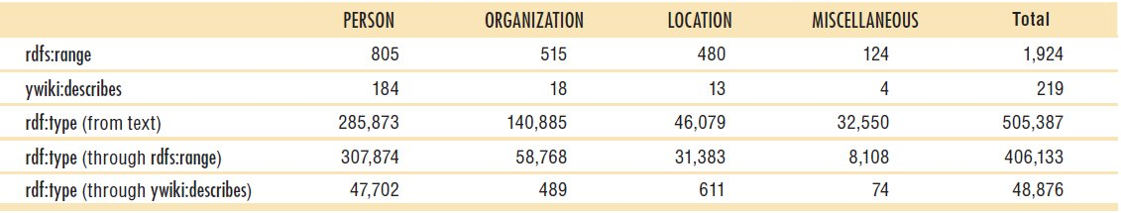
Result #1: extending metadata

Slide 29
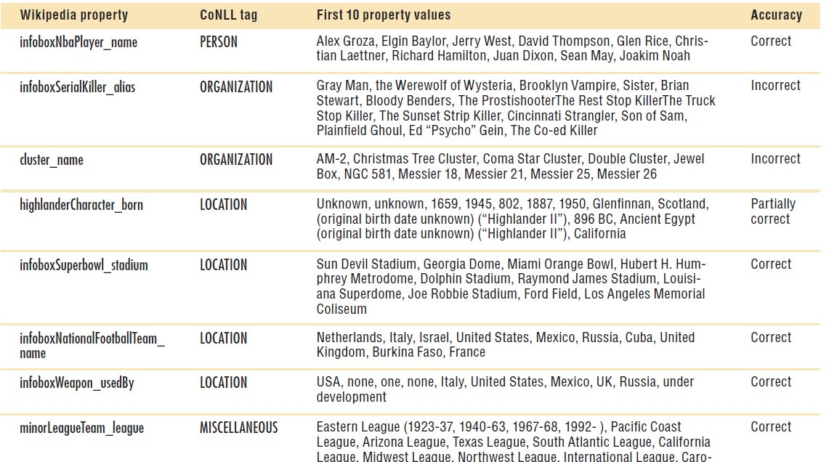
Result #1: extending metadata
Notes:
serialkiller aliases:

Slide 30
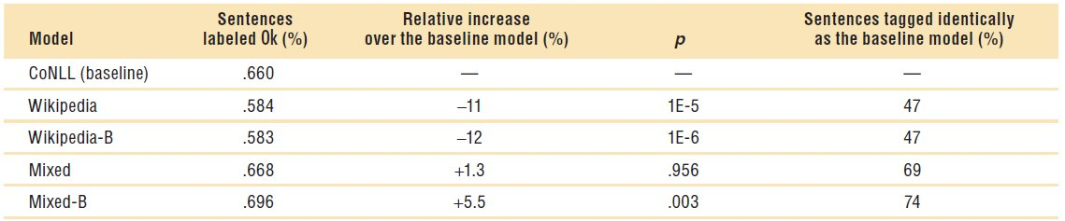
Result #2: improved tagging
Generate training data based on what is learned
e.g. if Paris is also a place of birth, it is also a place
Dealing with partially-labeled data
Paris is the capital city of France.
Automatic tuning of parameters on training set
User evaluation
Automatically generated training data is not much worse than baseline
Improves on existing tagger when training data is combined
Notes:
Work with Massimiliano Ciaramita….
Reference data in the table…

Slide 31
Exploiting metadata in HTML
Limited availability of structured data
Information boxes
Professional data providers or information extraction
Emerging standards for embedding structured data in HTML
Microformats, RDF-in-attributes (RDFa) released in 2007
Increasing amounts of data
Shared interest of publishers and search engines
Publishers are self-motivated in helping search engines understand their content
How can we exploit this data in web search?
Improve web search results presentation!

Slide 32
Presenting search results
Help users determine the relevance of search results
Title/Abstract/URL
Computing abstracts is hard
Summarization of HTML
Template detection
Selecting relevant snippets
Composing readable text
Efficiency constraints
Structured data to replace or complement text summary
Key/value pairs
Deep links
Image or Video
Notes:
Non-trivial problems to solve without publisher assistance

Slide 33
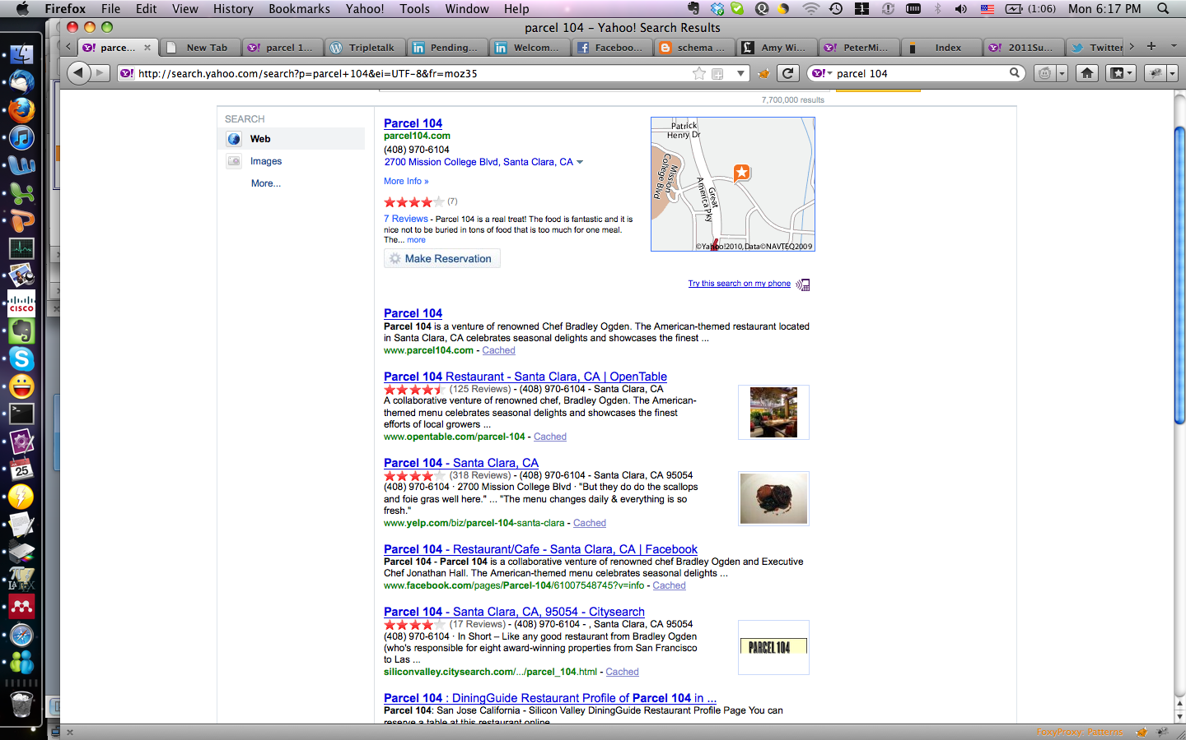
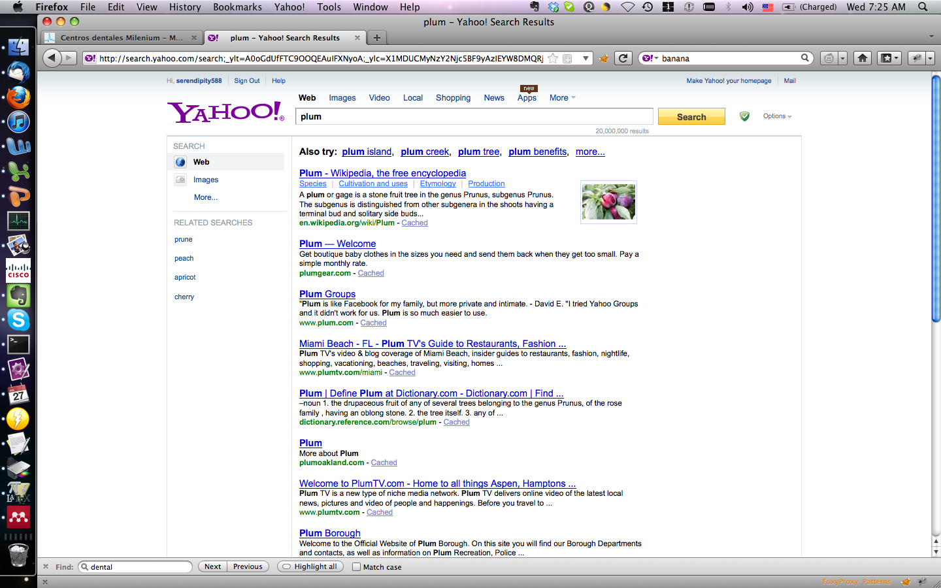
Enhanced results
Extract structured data
Semantic Web markup
Example:
<span property=“vcard:city”>Santa Clara</span>
<span property=“vcard:region”>CA</span>
Information Extraction
Presentation
Fixed presentation templates
One template per object type
Applications
Third-party modules to display data (SearchMonkey)

Slide 34
SearchMonkey architecture (2008)

Slide 35
Lessons learned
Enhanced results help users determine the relevance of search results
Fragmentation of markup
Schema.org to the rescue
See keynote talk on Wednesday
Humans are very effective at creating extraction rules
Our users won’t do it
But our editors will!

Slide 36
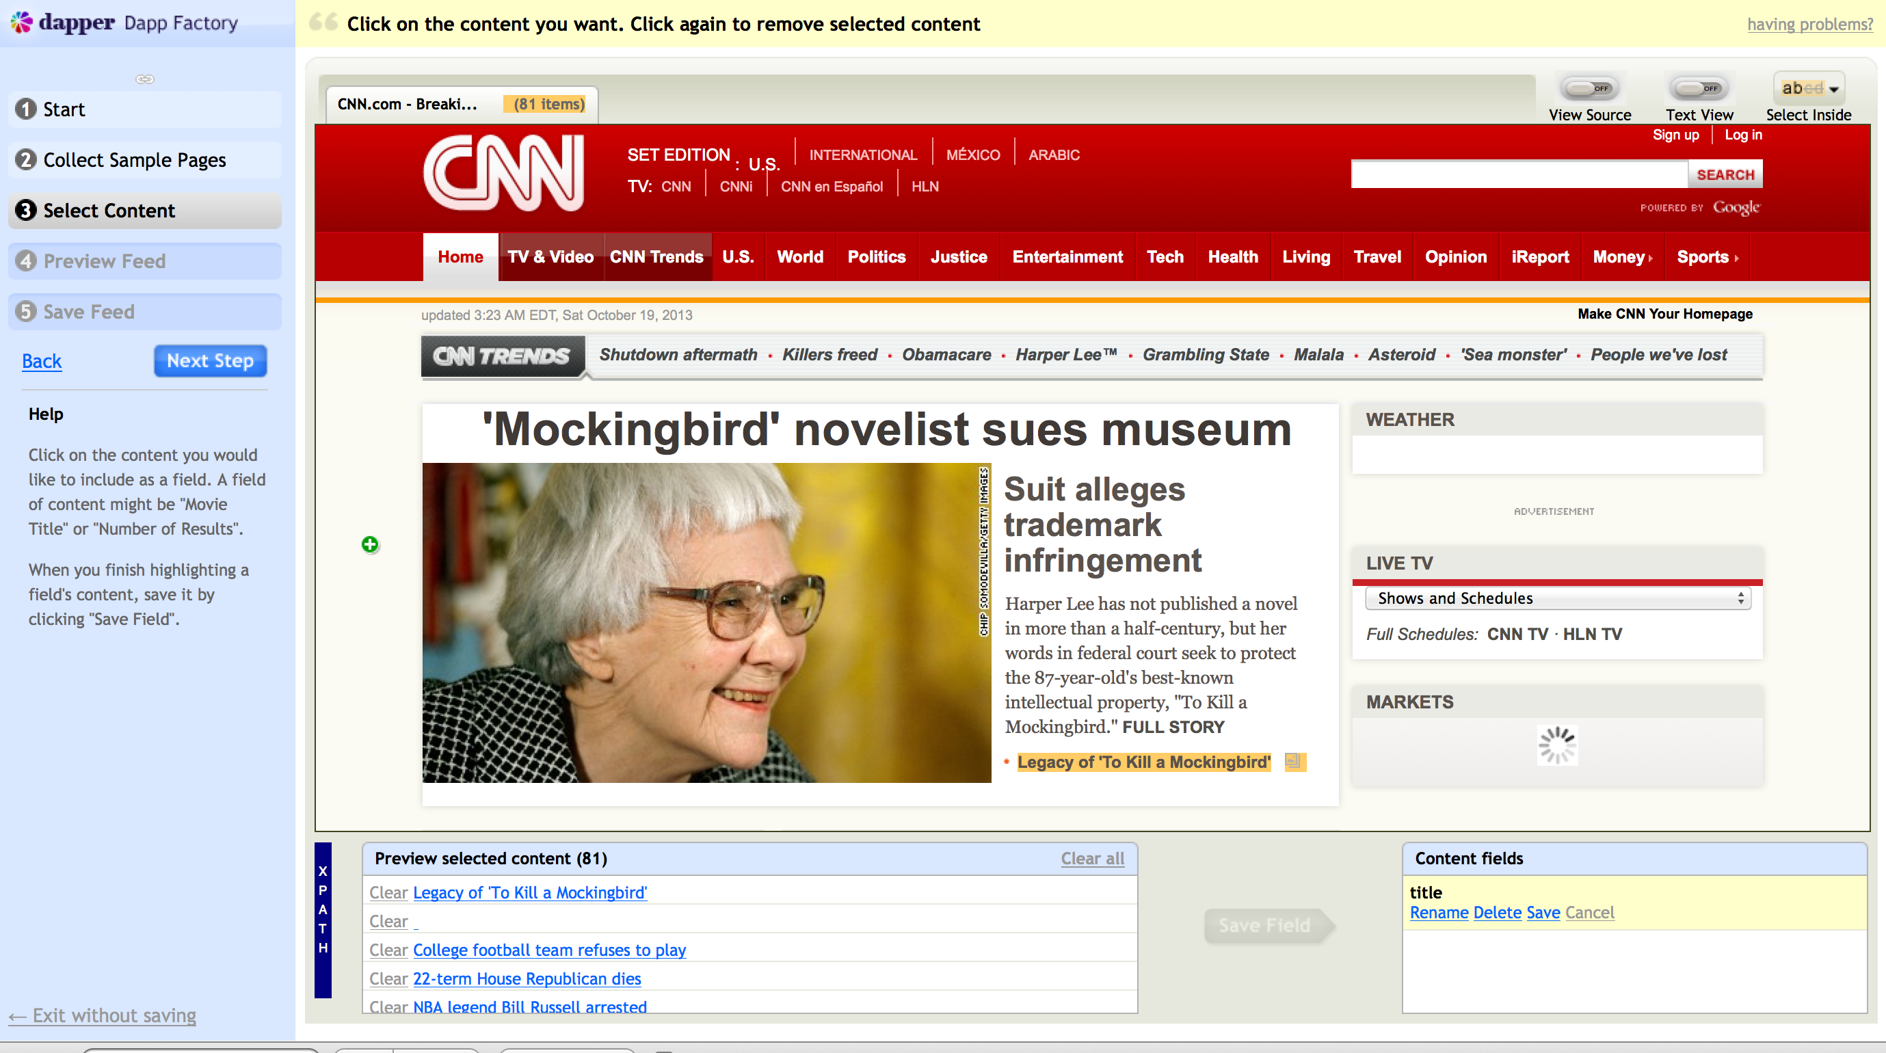
Semi-automated wrapper induction
Try it at open.dapper.net
Core technology for Direct Displays (DD)
1000s of DDs in production

Slide 37
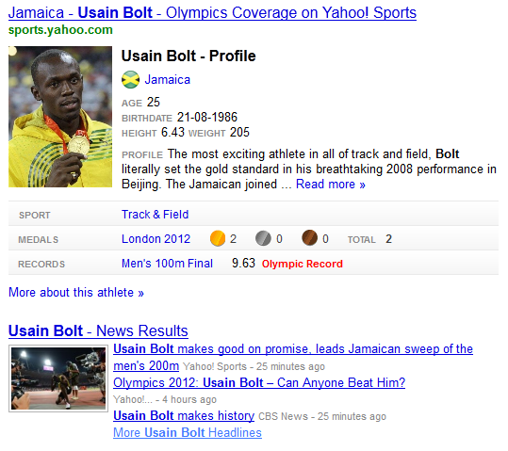
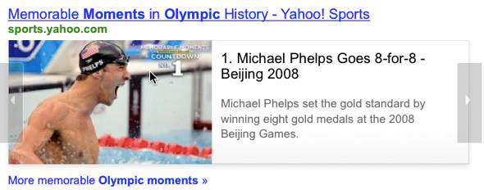
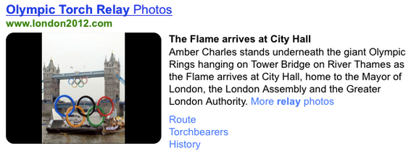
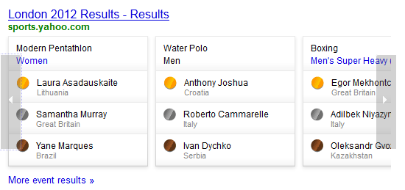
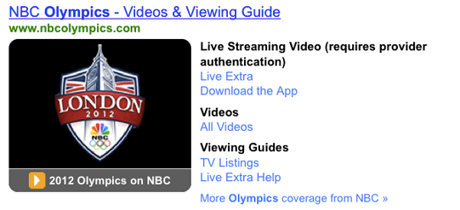
Olympics
Notes:
100 DDS in 27 markets
24.614% increase in CTR and 13.879% increase in DD Coverage

Slide 38
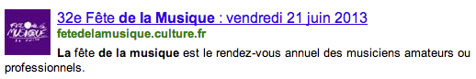
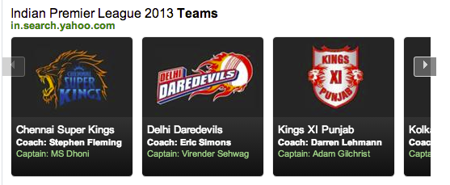
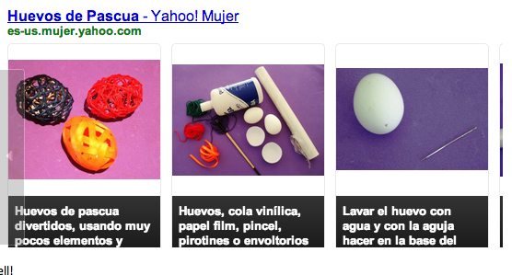
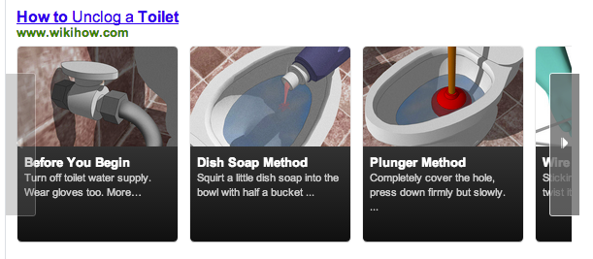

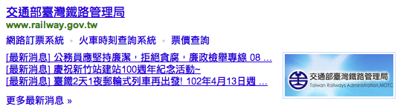
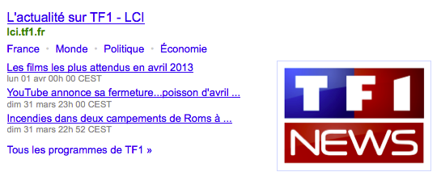


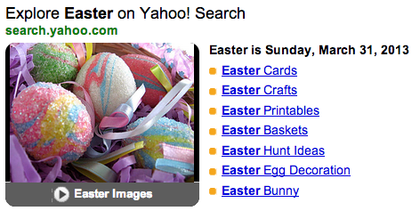
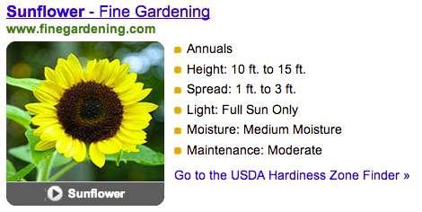
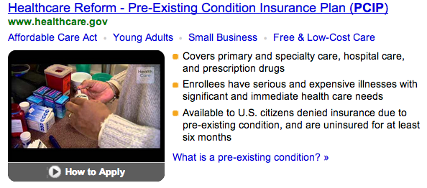
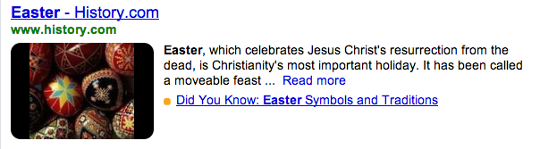
Variety of templates
Carousel
News
Events

Slide 39
Understanding users

Slide 40
Patterns in logs are hard to see
Sample of sessions from June, 2011 containing the term “moneyball”
What are users trying to do?
oakland as bradd pitt movie moneyball movies.yahoo.com oakland as wikipedia.org
captain america movies.yahoo.com moneyball trailer movies.yahoo.com
money moneyball movies.yahoo.com
moneyball movies.yahoo.com movies.yahoo.com en.wikipedia.org movies.yahoo.com peter brand peter brand oakland nymag.com moneyball the movie www.imdb.com
moneyball trailer movies.yahoo.com moneyball trailer
brad pitt brad pitt moneyball brad pitt moneyball movie brad pitt moneyball brad pitt moneyball oscar www.imdb.com
relay for life calvert ocunty www.relayforlife.org trailer for moneyball movies.yahoo.com moneyball.movie-trailer.com
moneyball en.wikipedia.org movies.yahoo.com map of africa www.africaguide.com
money ball movie www.imdb.com money ball movie trailer moneyball.movie-trailer.com
brad pitt new www.zimbio.com www.usaweekend.com www.ivillage.com www.ivillage.com brad pitt news news.search.yahoo.com moneyball trailer moneyball trailer www.imdb.com www.imdb.com
Notes:
One over-arching use case: checking out a movie… a sequence of actions such as reading about the movie, checking out the main character and watching the trailer
Large variety of sites that provide similar info, some users visit more sites than others
Does this hold for all movies? Recent releases?

Slide 41


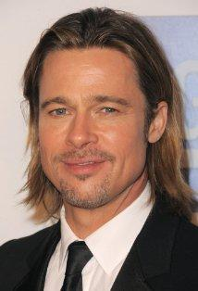
Semantic annotations help to generalize…
Sports team
oakland as bradd pitt movie moneyball trailer movies.yahoo.com oakland as wikipedia.org
Movie
Actor

Slide 42
… and understand user needs
Object of the query
what the user wants to do with it
moneyball trailer
Movie

Slide 43
Semantic analysis of query logs
Multiple approaches
Dictionary tagging
Match entities in a fixed dictionary
Scalable, high recall, not very precise
Entity retrieval
Retrieval an index of the knowledge base
Post-retrieval methods
Annotate a document corpus with entities
Retrieve documents and aggregate annotations
Applications
Usage mining
L. Hollink, P. Mika and R. Blanco. Web Usage Mining with Semantic Analysis. WWW 2013
Related-entity recommendations
R. Blanco, B. Cambazoglu, P. Mika, N. Torzec: Entity Recommendations in Web Search. ISWC 2013

Slide 44
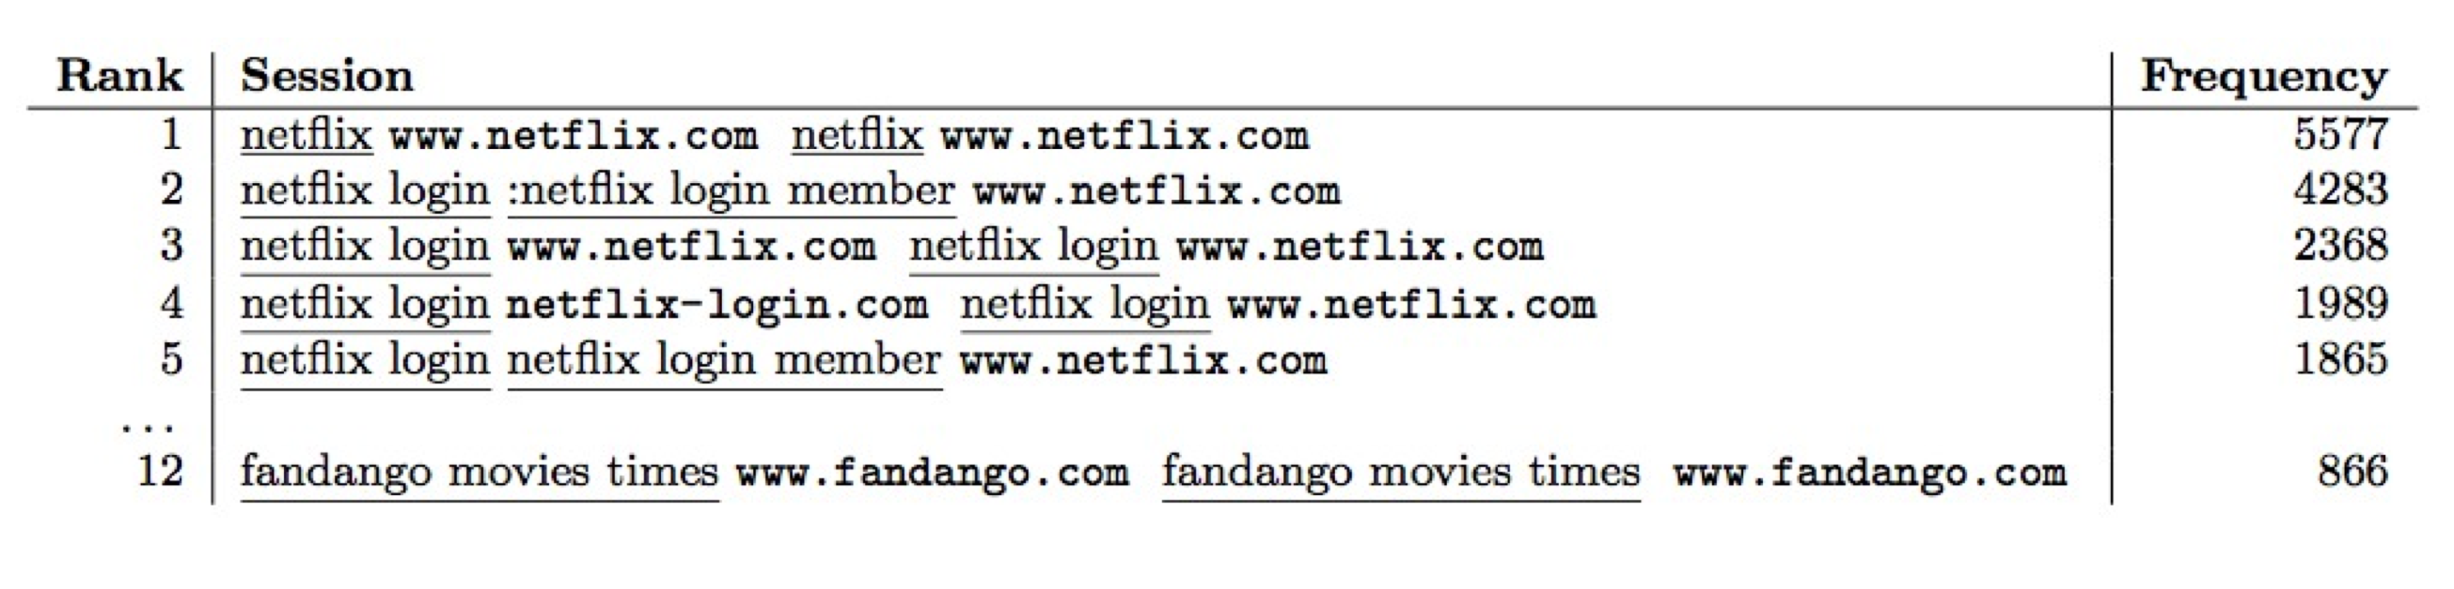
Usage mining
Site owners would like to find usage patterns
Reducing abandonment
Competitive analysis
Problem: patterns are lost in the data
64% of queries are unique within a year
Even the most frequent patterns have low support

Slide 45
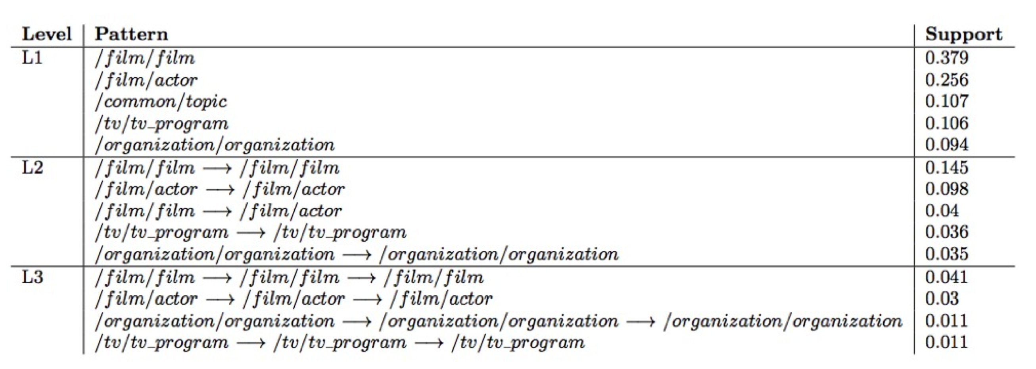
Solving the sparseness problem through annotation
Frequent patterns of annotations are more general and less noisy

Slide 46
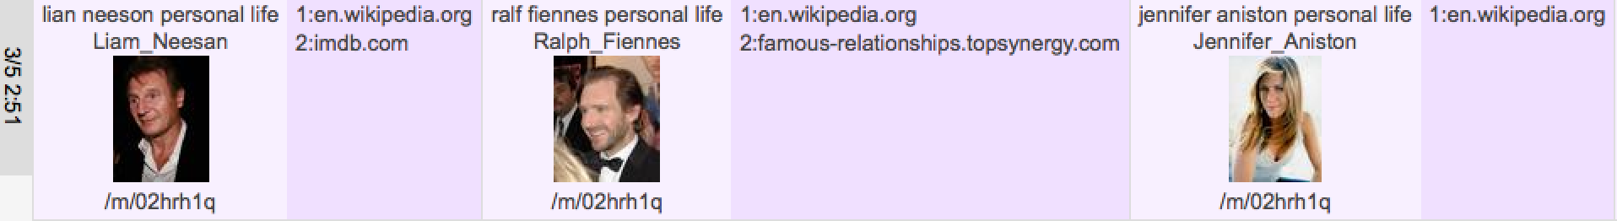
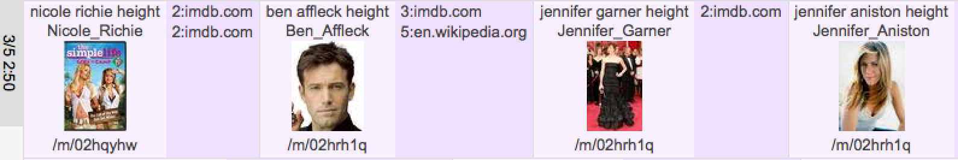
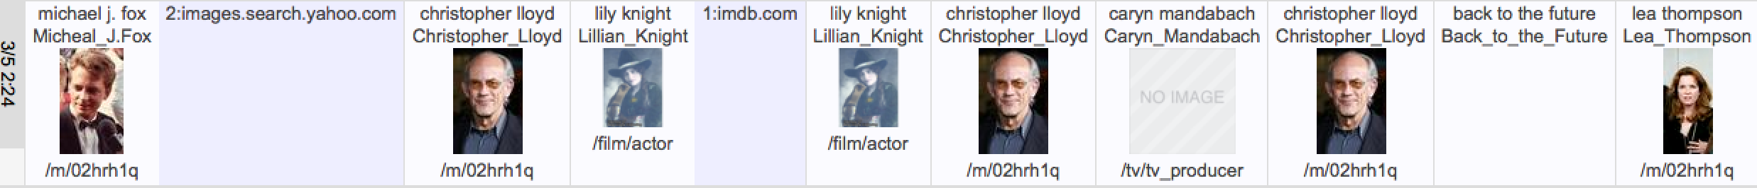
Example user sessions

Slide 47
Spark: related entity recommendations in web search
A search assistance tool for exploration
Recommend related entities given the user’s current query
Cf. Entity Search at SemSearch, TREC Entity Track
Ranking explicit relations in a Knowledge Base
Cf. TREC Related Entity Finding in LOD (REF-LOD) task
See talk on Wednesday

Slide 48
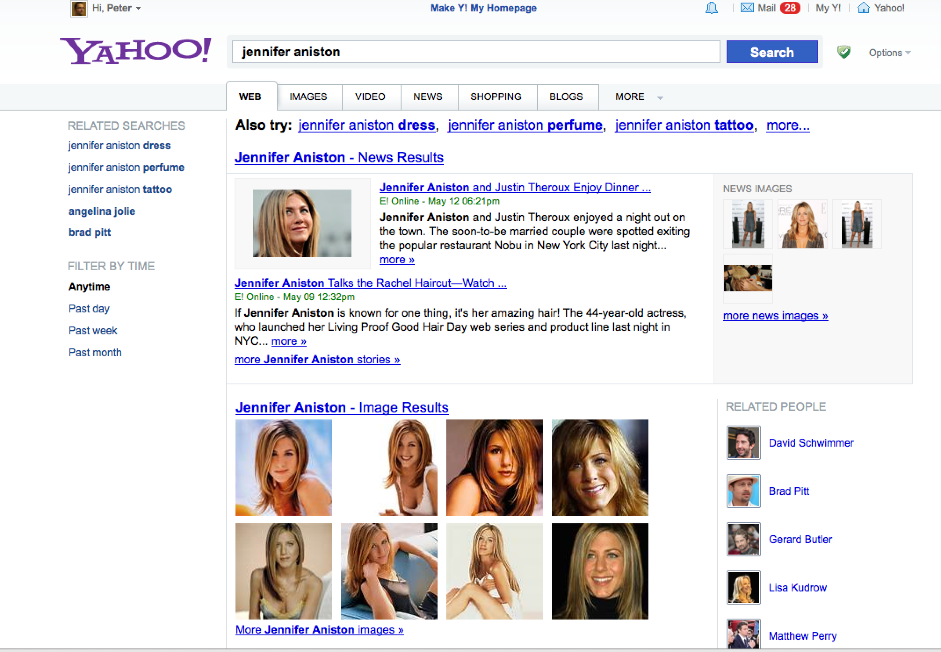
Spark example I.

Slide 49
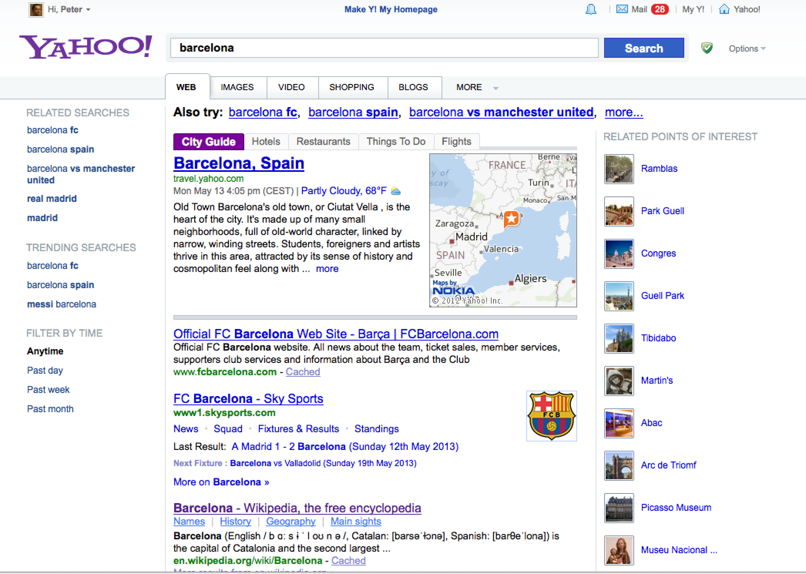
Spark example II.

Slide 50
Understanding interaction

Slide 51
Beyond nouns
Modeling transactional intent (“verbs”)
Initial ontology in Schema.org to model common set of web intents
Understanding human interaction
Critical in building dialogue systems

Slide 52
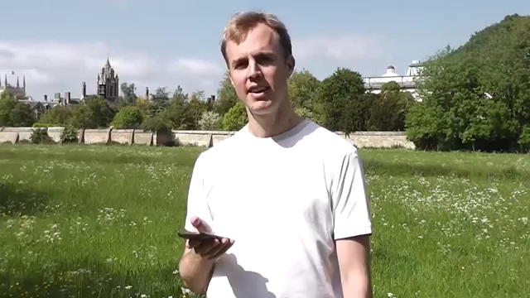
Example dialogue system (Parlance project)
Notes:
no application specific programming
everything trained from data

Slide 53


Components of a Spoken Dialog Systems (SDS)
I want to find a
restaurant?
inform(task=find, entity=restaurant)
User
Recognizer
(ASR)
Semantic
Decoder
Dialog
Control
Waveforms
Words
Dialog
Acts
The Web
Synthesizer
(TTS)
Message
Generator
What kind of food
would you like?
request(food)
Cloud-based support
already in place: eg Google Chrome, Nuance
Currently limited domain
Hand-crafted using rule-based parsers, template generators and flowchart-based dialog control
Expensive to build and fragile in operation
Slides courtesy of Steve Young, University of Cambridge, mi.eng.cam.ac.uk/~sjy
Notes:
Blue shaded components typically rely on ad hoc programming

Slide 54
A Statistical Spoken Dialogue System
Supervised Learning
Ontology
Id like italian {0.4}
I want an Italian {0.2}
Id like Indian{0.2}
In the east{0.1}
inform(food=italian){0.6}
inform(food=indian) {0.2}
inform(area=east){0.1}
null(){0.1}
I want an Italian
Belief
Propagation
ASR
Semantic
Decoder
Bayesian
Belief Network
Evidence
Food
Area
Belief
State
Ita
Ind
-
N
E
S
W
TTS
Response
Generator
Action
Stochastic
Policy
confirm(food=italian)
request(area)
You are looking for an Italian restaurant? Whereabouts?
Reinforcement
Learning
Rewards: success/fail
Reward Function
Partially Observable Markov Decision Process (POMDP)
Slides courtesy of Steve Young, University of Cambridge, mi.eng.cam.ac.uk/~sjy
Notes:
Key advantages:
cheaper to build
more robust in operation
can learn, adapt and improve online

Slide 55
Scaling Up
We can build a fully statistical spoken dialogue system for a specific narrow domain – but how do we scale up too much broader domains?
Wide coverage
ontology
Real
Users
Domain
Ontology
Real
Users
Domain
Ontology
Working
System
Crowd-sourced annotators
Data for input output mapping
Fast on-line reinforcement learning
CamInfo
Restaurant System
Personal
Assistant
User simulator for policy optimisation
Corpus Data for model parameter estimation
Corpus Data for model parameter estimation
Hand-crafted input, output,
and model parameters
Unsupervised
learning
Does not scale
Slides courtesy of Steve Young, University of Cambridge, mi.eng.cam.ac.uk/~sjy
Notes:
Current approaches do not scale.

Slide 56
Semantic Decoding
Need to learn mappings:
I’m trying to find an Italian restaurant.
I’m looking for a place that serves pizza.
inform( task=find, entity=restaurant,
food=Italian )
Given annotated data, use supervised learning eg SVMs, CRFs
Learning from unsupervised data is hard …
Example: search web and iteratively cluster contexts
Paris
Pittsburgh
Seattle
Montpelier
San Francisco
Berlin
denial
anxiety
selfishness
London
Learning
diverges
without
supervision
mayor of X
live in X
X is home of
traits such as X
In spoken dialogue, the user provides the required supervision through the natural conversational mechanisms of confirmation, correction and clarification
Slides courtesy of Steve Young, University of Cambridge, mi.eng.cam.ac.uk/~sjy
Notes:
Semantics – how do we learn named entities and the relationships between them?

Slide 57
Learning semantics on-line
In spoken dialogue, the user can implicitly supervise learning …
p(food=unknown)=0.4
p(food=italian) =0.6
p(food=unknown)=1.0
p(food=Italian) =0.0
p(food=unknown)=0.0
p(food=italian) =1.0
p(food=unknown)=0.2
p(food=italian) =0.8
p(food=unknown)=0.5
p(food=italian) =0.5
p(food=unknown)=0.4
p(food=italian) =0.6
p(food=unknown)=0.1
p(food=italian) =0.9
p(food=unknown)=1.0
p(food=italian) =0.0
g₁
g₂
g₃
a₁
a₂
a₃
What kind of food do you want?
Sorry, I don’t understand. What kind of food do you want?
So you want
Italian. Is that correct?
u₁
u₂
u₃
W₁
W₂
W₃
I’d like pizza
Could I have Italian food?
Yes!
Expectation Propagation
Expectation Propagation
Expectation Propagation
p(pizza|food=italian)
~ large
p(pizza|food=italian)
~ medium
p(pizza|food=italian)
~ small
Slides courtesy of Steve Young, University of Cambridge, mi.eng.cam.ac.uk/~sjy
Notes:
Unlike off-line text corpora, the user of a spoken dialogue system can provide light supervision.

Slide 58
Web Scale Spoken Dialogue
Wide coverage
ontology
Domain
Ontology
Real
Users
Fast on-line reinforcement learning
Personal
Assistant
Corpus Data for model parameter estimation
User-supervised
learning
Slides courtesy of Steve Young, University of Cambridge, mi.eng.cam.ac.uk/~sjy
Notes:
Using the framework of statistical spoken dialogue
users can explore previously unseen domains
new semantic relationships can be discovered
policies can adapt on-the-fly to respond intelligently in new situations
users themselves supervise learning
learning is fast because many users interacting in parallel

Slide 59
Summary
Semantic Search requires
Understanding user queries, content and interaction
Mapping to a shared conceptual space
Information Extraction is key to realizing Semantic Search
But need to move beyond just IE on text documents!

Slide 60
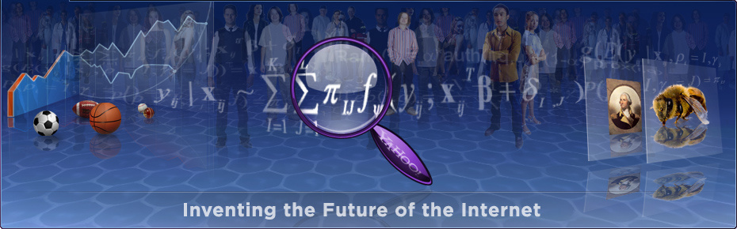
The End
Many thanks to my colleagues at Yahoo
Slides on Spoken Dialogue Systems courtesy of Steve Young, University of Cambridge
Contact
pmika@yahoo-inc.com
@pmika
Internships available for PhD students

